Slide 1
AI Champions Bootcamp Project Scoping Template
<your name, designation, org>
Adapted From Data Literacy ePrimer – Module 5

Slide 2
Note
This Project Scoping Template is part of the Data Literacy ePrimer.
Should you need more info on how to use this Project Scoping guide, the Data Literacy ePrimer (Module 5) on the LEARN app carries a detailed explanation.
You can duplicate any slides if you have longer content for a particular section, so you can continue writing on next slide. Feel free to add new slides or sections to better convey the info about the project

Slide 3
<your project title>

Slide 4

Problem Statement: The Problem
<Describe the problem you are trying to solve>
<At the end, sharpen it into a question>

Slide 5

Problem Statement: Urgency & Severity
<What is wrong with the current situation?> (e.g. How does this problem affect your agency or involved individuals?)
<What is the magnitude of this problem?> (e.g. number officers/citizens are affected, financial costs incurred, or productivity hours affected)

Slide 6

Proposed Solution
<How would you try to solve this problem?>
<How would you think Large Language Model(s) can be used to support your solution?>
<Are there any alternative solutions you have considered?>

Slide 7

Impact (part 1 of 2)
<How would things be improved after the solution is implemented?>
With the immediate state where the app is to be used by our reps, we envision that the solution will be able to reduce the time needed to the “eligibility check” inquiries from 6 hours to only 2 hours, equivalent to a saving of 29,000 productivity hours (approximately $600,000) per year.
It also allows the reps to spend more time and attention on the inquiries that truly need the expertise of the reps, which also account for more than 70% of the value created by our organisation (approximately $50 million per year). The waiting time for inquiries should also be reduced to less than 8 hours on average and therefore overall improvement in the customer satisfaction to a satisfactory level of 4.5 and above.
<How often the solution will be used?>
For the immediate state, where the app is used by internal reps to generate the first-cut of eligibility assessment and justifications, we estimate the app be used by our 30 reps daily for 2 hours per day per day (down from 6 hours based on current workflow), over 5-day workweek.

Slide 8
Impact (part 2 of 2)
<What is the number of potential users can be benefited by the solution in long-run?>
For the long-term goal of exposing the app as a tool on the user portal (website), we estimate the app will be used by 40,000 of our users, with about 500-600 inquiries per day.
<What is the estimated time-saving or financial-saving per year (from the agency’s or WOG perspective)>
We envision that the solution will be able to reduce the time needed to the “eligibility check” inquiries from 6 hours to only 2 hours, equivalent to a saving of 29,000 productivity hours (approximately $600,000) per year. Conservatively, it could also reduce the turnover rate by 50%, lead to a saving of $75,000 year.
With the reduced workloads for the team, some members can be assigned to work on works with significant value for the organization, such as design of more effective grant schemes. The additional value creation with 11,500 hours (16 hours per week x 4 weeks x 12 months x 15 staff* ) on the high-value tasks is estimated to be $230,000 a year (based on value of $40 per hours, as opposed to $20 per hours).
The total estimated financial saving per year is: $900,000 per year.

Slide 9

Stakeholders & Users
<Is this project’s impact big enough to get the attention of the senior management?>
Yes, this project proposal has been presented/discussed at the senior management forum of our agency by our director. The management has endorsed the team to pursue this project further by first establishing a proof-of-concept prototypes that can be tested by a smaller group of the users (reps). From the user testing, we wish to collect data to build a strong case to get additional resource support from the management, such as the help from our IT team to deploy this onto our system. Therefore, a working prototype is important to allow us to collect usage data, user satisfaction, and to estimate/extrapolate the productivity gains of such a tool.
<Who are the users of the LLM applications?>
For the immediate phase, our 30 customer service representatives (reps) will be the users of the applications, to quickly assess the client and draft the initial response.
The long-term goal is to allow our 40,000 clients to use the matured version of the tool directly on the user portal (website).

Slide 10

Available Data and Samples
<What are relevant data do you currently collect and already have?>
<Is there any data that require approval to be used in the project?>
<Please provide a data dictionary and a sample set of the data*>
*please share a mockup (dummy) data samples

Slide 11

Data Classification
<What is the Classification/Sensitivity of Data?>
<Can the data be down class to “Official (Closed)” by using mock data (or dummy data) of the same structure and characteristics?>

Slide 12

Lines Of Inquiry
<What are some of your hypothesis, or assumptions which you would like to be validated?>
<How will you test your hypotheses or validate your assumptions?

Slide 13
Methodology (Flow Chart)
<Use flow chart to describe the series of the processes involved in your approach>
<Include the data sources (e.g., dataset, APIs, user inputs) that go into the process, and the steps involved in preparing the data for the LLM)
<This can also include how the output of LLM is evaluated>
(You may use draw.io (diagrams.net), Excalidraw, or any other diagramming tools)

Slide 14
Methodology (Flow Chart)
Other Tips on the Methodology’s Flow Chart
Use Clear Labels: Ensure each step is clearly labeled with concise descriptions.
Logical Flow: Arrange the steps in a logical order that reflects the actual process.
Visual Clarity: Use shapes and arrows to clearly indicate the flow and connections between steps.
Consistency: Maintain a consistent style and format throughout the flow chart.
Highlight Key Points: Use colors or bold text to highlight critical steps or decisions.

Slide 15
Mock Up
<Feel free to duplicate this slide>
<Each “page” of your app should have a slide that contains the mock-up of the page>
<Shows the inputs required from user and other key components that will be shown in the page>

Slide 16
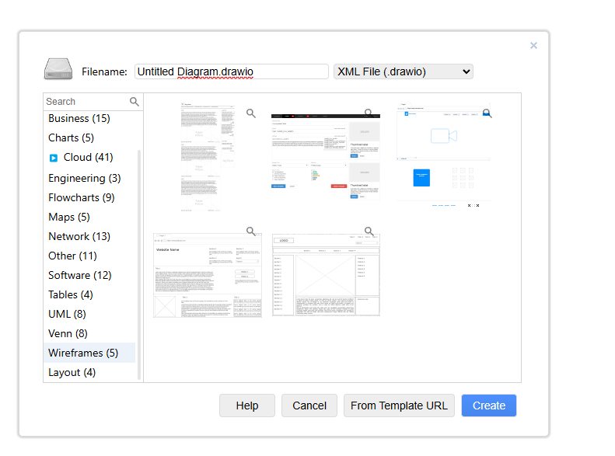
Mock Up
You may use draw.io (diagrams.net), Excalidraw, or any other diagramming tools

Slide 17

Obstacles
<Do you foresee obstacles in implementing the solutions?>
<What resources (financial, human, technical) will be needed to overcome these obstacles?>

